Slide 1
WHAT IS IMPACT MAPPING AND WHY DO YOU NEED IT?
Omar Derick Cura
ICP-ACC,CSM,CSPO,MCP
November 8, 2018
Version 1.0

Slide 2
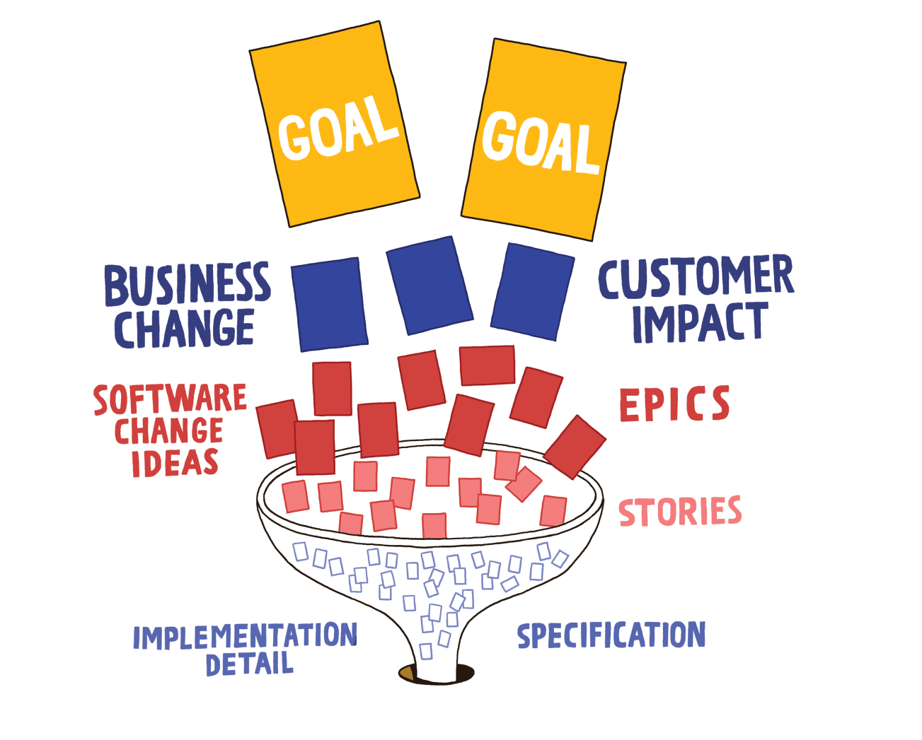
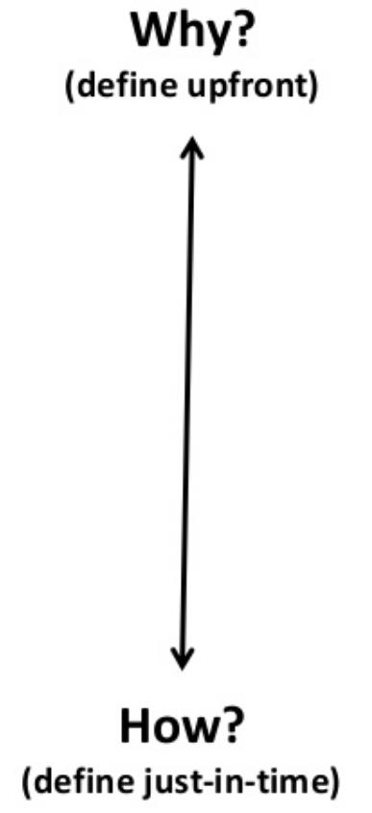
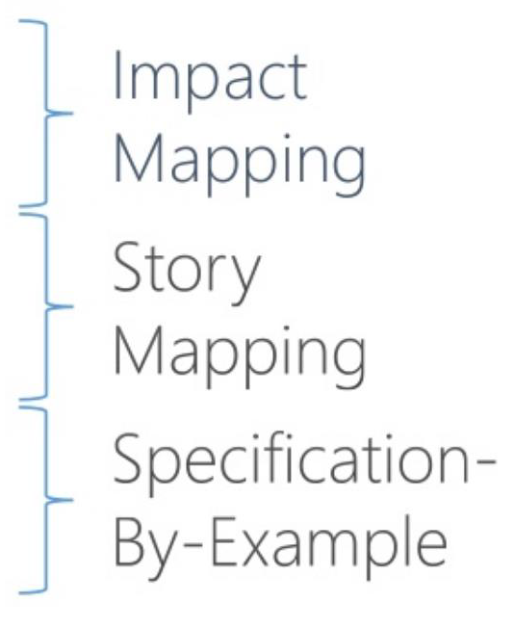
What is Impact Mapping?
Idea
Need
Problem
Notes:
Impact mapping is a strategic planning technique. It prevents organizations from getting lost while building products and delivering projects, by clearly communicating assumptions, helping teams align their activities with overall business objectives and make better roadmap decisions.

Slide 3
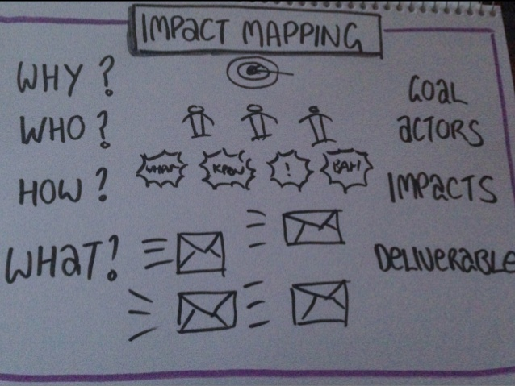
What is Impact Mapping?
Impact mapping is a strategic planning technique that lets your team set business goals and visualize the way and the means to achieve these goals.
It help teams plan better by helping “Business Leaders” and “Technical Teams” collaboratively explore how to achieve desired business outcomes.
Notes:
Impact mapping is a strategic planning technique. It prevents organisations from getting lost while building products and delivering projects, by clearly communicating assumptions, helping teams align their activities with overall business objectives and make better roadmap decisions.

Slide 4
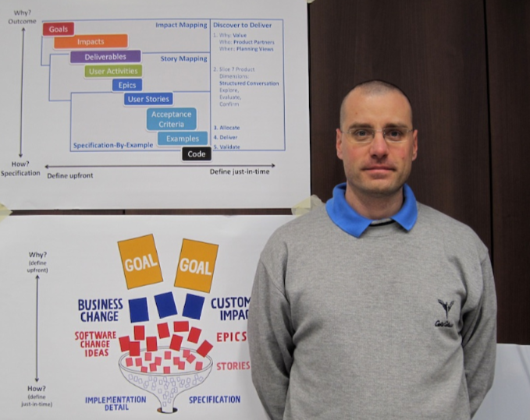
Background and Evolution of Impact Mapping
Impact mapping is a visual mapping technique for product development. Gojko Adzic, a Serbian software consultant — who moved to the UK — invented this method to align development teams to business objectives, to test mutual understanding of goals and expected outcomes with stakeholders, to focus teams toward the highest value features to deliver, and to enable collaborative decision-making
Notes:
The term "impact" in this context refers to a human behavioral change, something affected by the delivery of a product feature or a process change. Impact mapping defines the value of any work effort in terms of its "impact" (not merely its "completion"). This idea comes to us from the design thinking community, and has significant implications for the ways leaders incentivize risk-taking and therefore innovation (as I'll discuss in the next section).
The term "mapping" is derived from the concept of the "mind map," which participants build as part of the workshop. This special kind of mind map—also known as an "impact map"—is carefully constructed to surface the assumptions underlying a work effort. Specifically, impact mapping seeks to highlight all assumptions that:
a specific deliverable will lead to a specific behavioral change, and
a particular behavioral change will help the organization achieve its goal
True to its lean product development roots, impact mapping provides a framework for using metrics to translate these assumptions into testable hypotheses.
Given the high value of the outputs of impact mapping, you may be surprised to learn that facilitating the technique is actually fast and cheap. It requires no expensive tools or training, so barriers to entry are low. If you'd like to use it in its simplest form, you can probably begin by reverse engineering a map without metrics from the project on which you are currently working. It will take you about 30 minutes at the whiteboard. With approximately four hours, a prepared facilitator can lead key stakeholders to an impact map with basic metrics for your next strategic initiative. More complete maps require an additional preparation phase to create comprehensive metrics. But these extra tasks are asynchronous, so completing an impact map won't require locking a team in a room for weeks at a time (instead you can schedule the process around busy stakeholders).

Slide 5
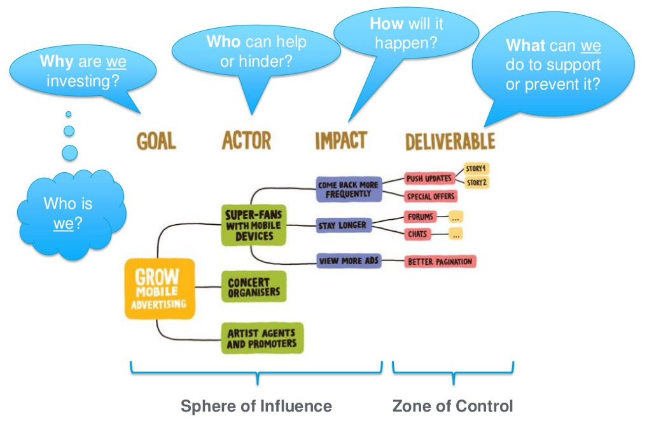
Impact Mapping
Notes:
Impact mapping is a strategic planning technique. It prevents organisations from getting lost while building products and delivering projects, by clearly communicating assumptions, helping teams align their activities with overall business objectives and make better roadmap decisions.

Slide 6
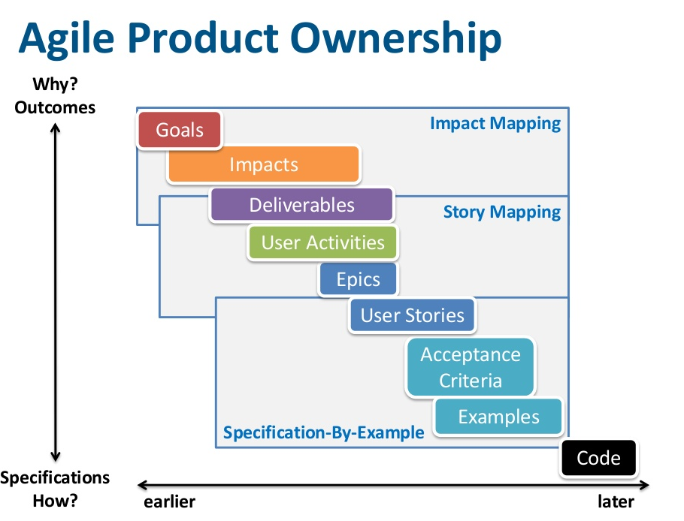
Agile Product Ownership
Notes:
Impact mapping is a strategic planning technique. It prevents organizations from getting lost while building products and delivering projects, by clearly communicating assumptions, helping teams align their activities with overall business objectives and make better roadmap decisions.

Slide 7
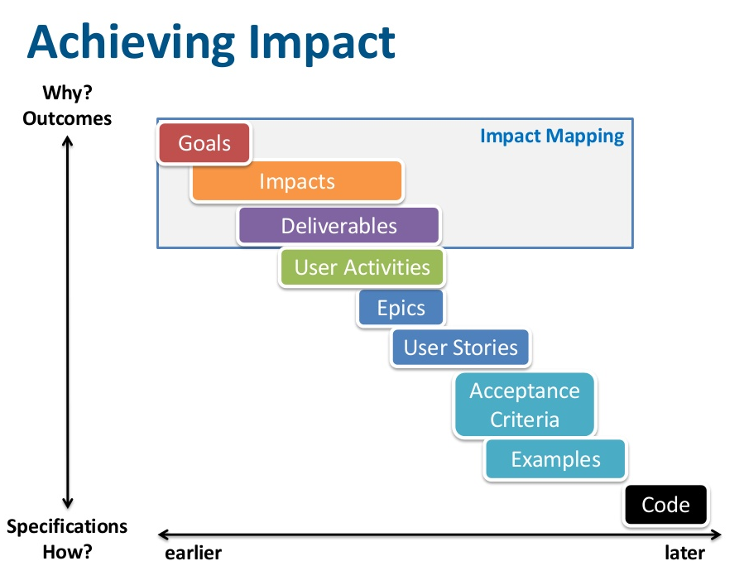
Achieving Impact
Notes:
Impact mapping is a strategic planning technique. It prevents organizations from getting lost while building products and delivering projects, by clearly communicating assumptions, helping teams align their activities with overall business objectives and make better roadmap decisions.

Slide 8
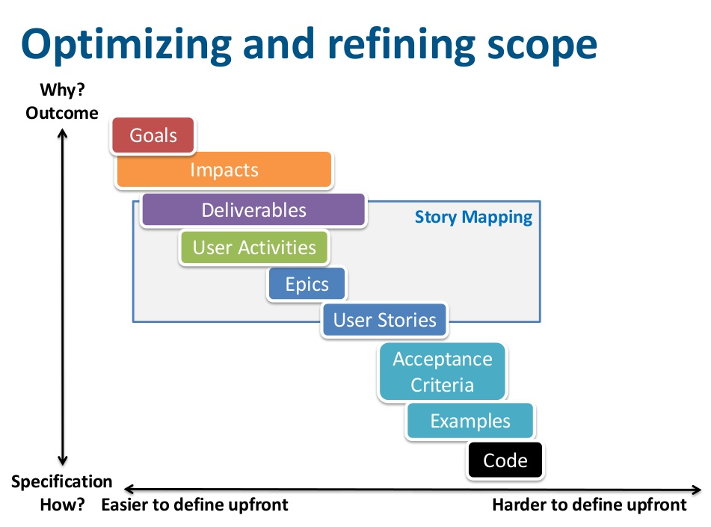
Optimizing and refining scope
Notes:
Impact mapping is a strategic planning technique. It prevents organizations from getting lost while building products and delivering projects, by clearly communicating assumptions, helping teams align their activities with overall business objectives and make better roadmap decisions.

Slide 9
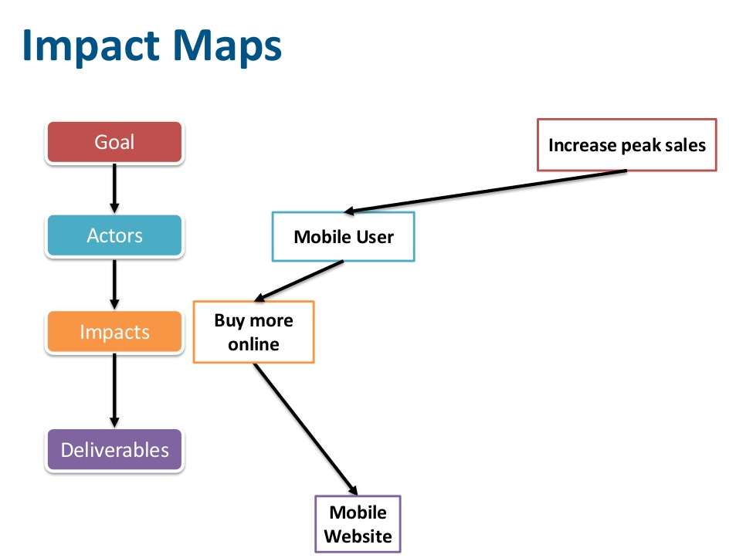
Impact Maps
Notes:
Impact mapping is a strategic planning technique. It prevents organizations from getting lost while building products and delivering projects, by clearly communicating assumptions, helping teams align their activities with overall business objectives and make better roadmap decisions.

Slide 10
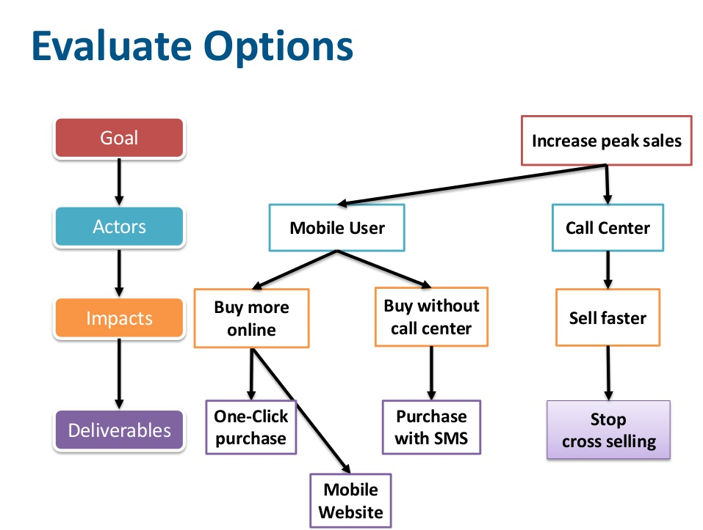
Evaluating Options
Notes:
Impact mapping is a strategic planning technique. It prevents organizations from getting lost while building products and delivering projects, by clearly communicating assumptions, helping teams align their activities with overall business objectives and make better roadmap decisions.

Slide 11
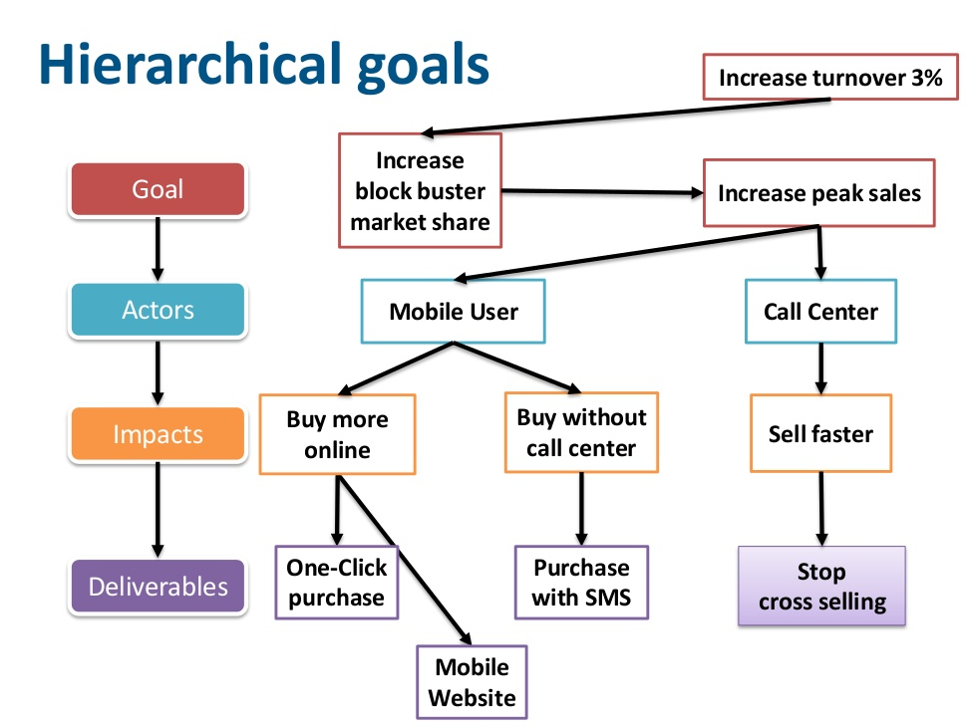
Hierarchical goals
Notes:
Impact mapping is a strategic planning technique. It prevents organizations from getting lost while building products and delivering projects, by clearly communicating assumptions, helping teams align their activities with overall business objectives and make better roadmap decisions.

Slide 12
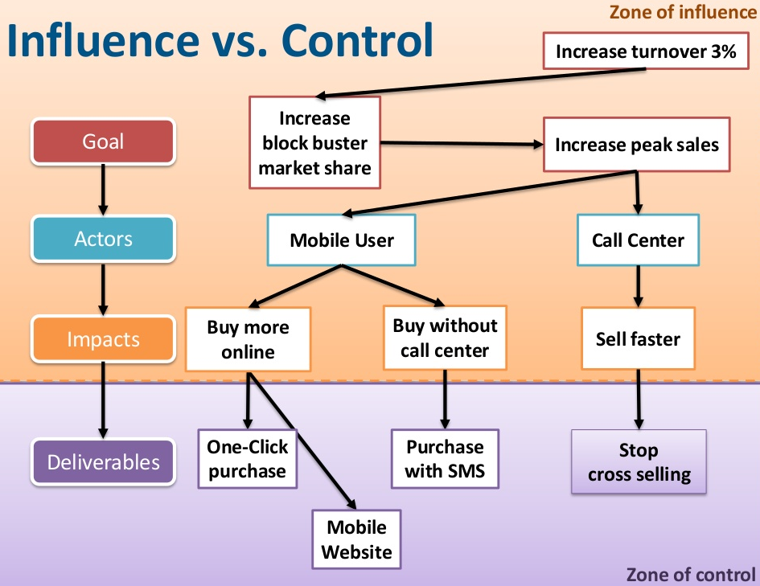
Influence vs. Control
Notes:
Impact mapping is a strategic planning technique. It prevents organizations from getting lost while building products and delivering projects, by clearly communicating assumptions, helping teams align their activities with overall business objectives and make better roadmap decisions.

Slide 13
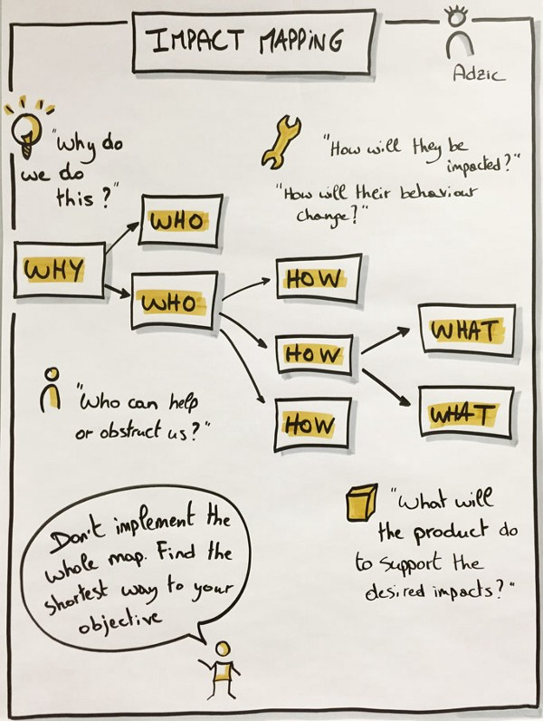
Purpose of Impact Mapping
Strategic Planning – Strategic goals for new products (deliverables); New products (deliverables) for new strategic goals
Define Quality – Agreements on purpose of deliverables Agreements on metrics of change
Roadmap Management – Agreements to achieve Business goals Frequent iterative releases to measure progress Agreements on metrics for central business goals

Slide 14
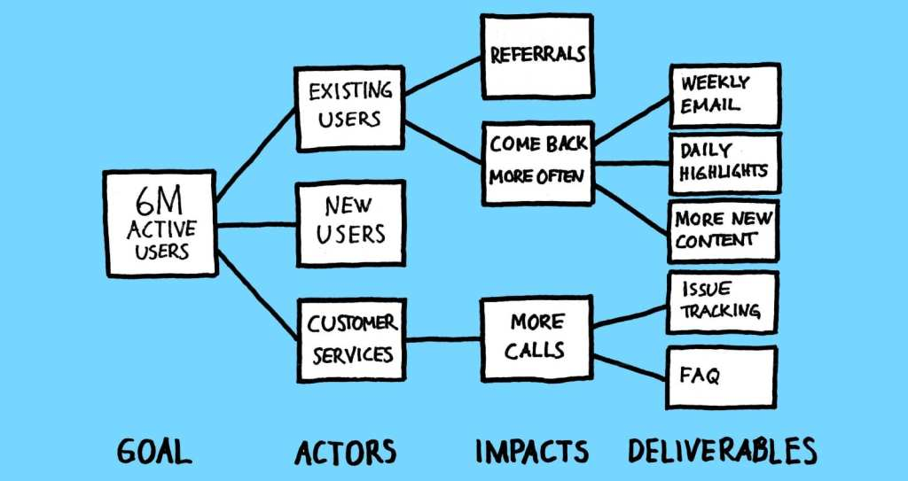
Advantages of Impact Mapping
It facilitates collaboration and interaction.
It visualizes assumptions.
It is fast.
It helps to reduce waste
Notes:
It is based on a method invented by an interaction design agency and similar to a team-building method, which means that it facilitates collaboration and interaction. It is significantly less bureaucratic and much easier to apply than many alternatives. It also facilitates the participation of groups of people from different backgrounds, including technical delivery experts and business users, helping organizations use the wisdom of crowds.
It visualizes assumptions. Alternative models mostly do not communicate assumptions clearly. Impact mapping does, and because of that it helps teams to make better decisions in rapidly changing environments such as IT. The visual nature of this method also facilitates effective meetings and supports big-picture thinking, which provides organizational alignment.
It is fast. One of my clients recently said that it would take them months to achieve what we did in just two days. Because of this, it fits nicely with iterative delivery models that are now becoming mainstream in software.
It helps to reduce waste by preventing scope creep and over-engineered solutions.

Slide 15
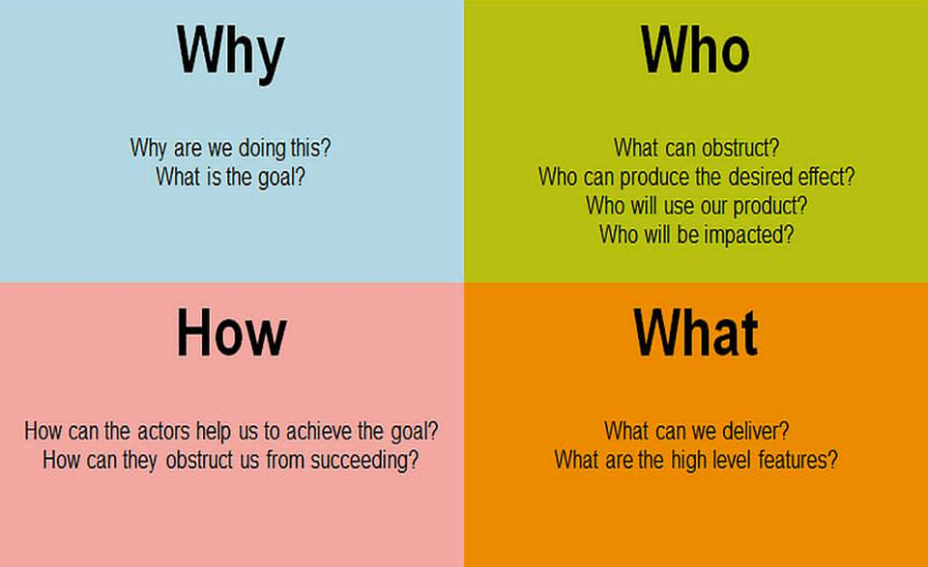
The "Why", The "Who", The "How", and The "What"

Slide 16
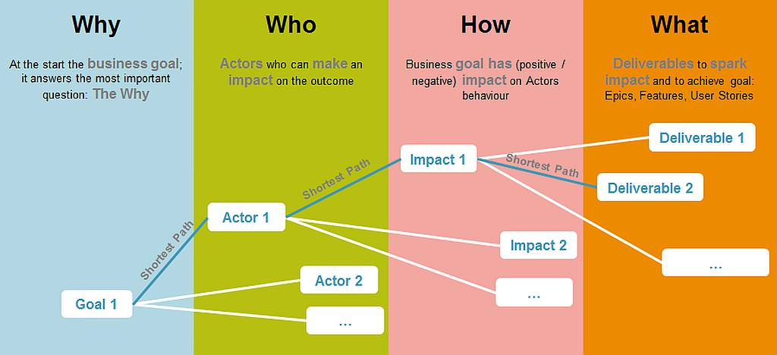
The "Why", The "Who", The "How", and The "What"
Why – The central node describes the goal of the initiative in a quantitative manner such that it can be measured.
Who – These are the people who can either be a help or a hindrance in achieving the goal.
How – These are impacts that need to be had on the actors for them to either help achieve the goal, or minimise/avoid them being a hindrance.
What – These are the deliverables which are hoped will create the impact on the actors to achieve the goal.

Slide 17
Who Aka Actors
Next, you list the user roles who will be impacted by the objective. This allows you to discover and formulate the desired changes in behavior for reaching it (Persona’s are often used to create such tangible ‘example users’ in order to facilitate communication and requirements understanding). Keep in mind that there might be several personas such as coordinators, marketing guys, accounting staff or the end-customer. That depends strongly on your product. Identify those people that can help you reach your objective, obstruct you in reaching it, or that will be impacted by the new product.
Notes:
Next, you list the user roles who will be impacted by the objective. This allows you to discover and formulate the desired changes in behavior for reaching it (Persona’s are often used to create such tangible ‘example users’ in order to facilitate communication and requirements understanding). Keep in mind that there might be several personas such as coordinators, marketing guys, accounting staff or the end-customer. That depends strongly on your product. Identify those people that can help you reach your objective, obstruct you in reaching it, or that will be impacted by the new product.

Slide 18

Why Aka Goal
Notes:
Discuss & put in the center of a flip-chart a goal you want to achieve (satisfying SMART criteria would be great). It answers the first question: WHYdo we do this?”. Good example: “Get 1M users”.

Slide 19
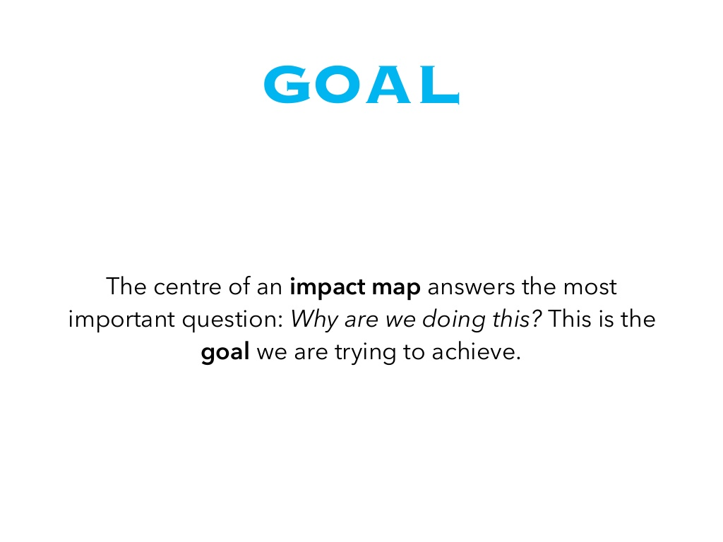
Why Aka Goal
Notes:
Discuss & put in the center of a flip-chart a goal you want to achieve (satisfying SMART criteria would be great). It answers the first question: WHYdo we do this?”. Good example: “Get 1M users”.

Slide 20
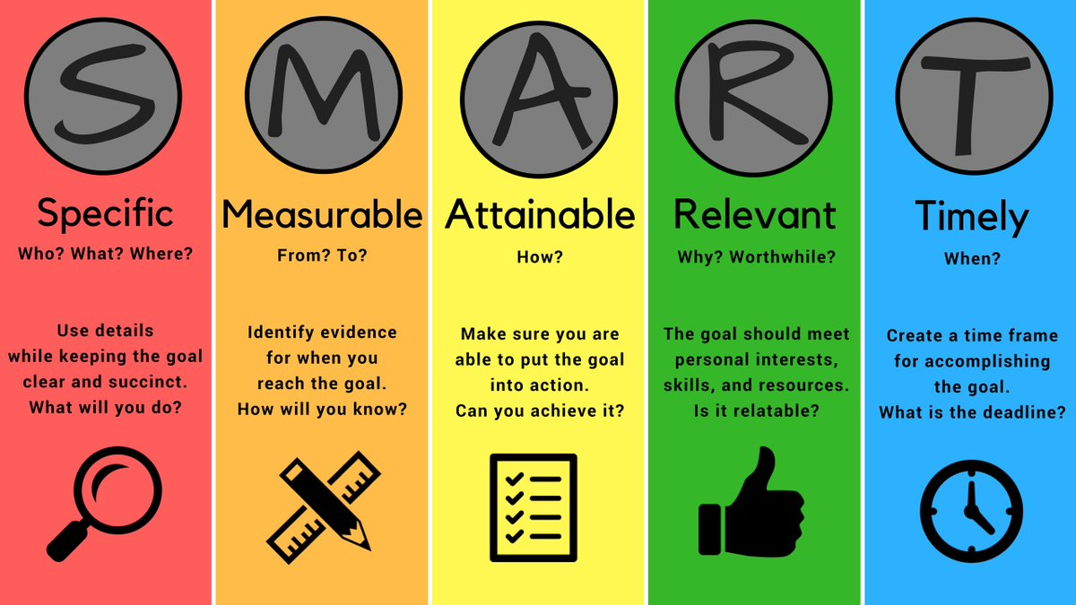
Why Aka Goal
To answer the "Why" question, Gojko suggests to use the acronym “SMART”: “Specific, Measurable, Action-oriented, Realistic, and Timely”
Notes:
SMART is a mnemonic acronym, giving criteria to guide in the setting of objectives, for example in project management, employee-performance management and personal development. The letters S and M generally mean specific and measurable. Possibly the most common version has the remaining letters referring to achievable, relevant and time-bound. However, the term's inventor had a slightly different version and the letters have meant different things to different authors, as described below. Additional letters have been added by some authors.
The first-known use of the term occurs in the November 1981 issue of Management Review by George T. Doran.^{[1]} The principal advantage of SMART objectives is that they are easier to understand and to know when they have been done. SMART criteria are commonly associated with Peter Drucker's management by objectives concept.^{[2]}
Often the term S.M.A.R.T Goals and S.M.A.R.T Objectives will surface. Although the acronym SMART generally stays the same, objectives and goals can differ. Goals are the distinct purpose that is to be anticipated from the assignment or project. ^{[3]} Objectives on the other hand are the determined steps that will direct full completion of the project goals.
History[edit]
The November 1981 issue of Management Review contained a paper by George T. Doran called There's a S.M.A.R.T. way to write management's goals and objectives.^{[1][4]} It discussed the importance of objectives and the difficulty of setting them.
Ideally speaking, each corporate, department, and section objective should be:
Specific – target a specific area for improvement.
Measurable – quantify or at least suggest an indicator of progress.
Assignable – specify who will do it.
Realistic – state what results can realistically be achieved, given available resources.
Time-related – specify when the result(s) can be achieved.
Notice that these criteria don't say that all objectives must be quantified on all levels of management. In certain situations it is not realistic to attempt quantification, particularly in staff middle-management positions. Practicing managers and corporations can lose the benefit of a more abstract objective in order to gain quantification. It is the combination of the objective and its action plan that is really important. Therefore serious management should focus on these twins and not just the objective.
— George T. Doran, There's a S.M.A.R.T. way to write management's goals and objectives^{[1][4]}

Slide 21

Who Aka Actors
Notes:
Discuss and try to answer next questions: WHO can produce the desired effect? WHO can obstruct it? WHO are the consumers or users of our product? WHO will be impacted by it? Here we think about real groups of people, not tech abstracts. Good examples: “Active Users”, “Our Marketing Guys”, “External Advertising Agency”.

Slide 22
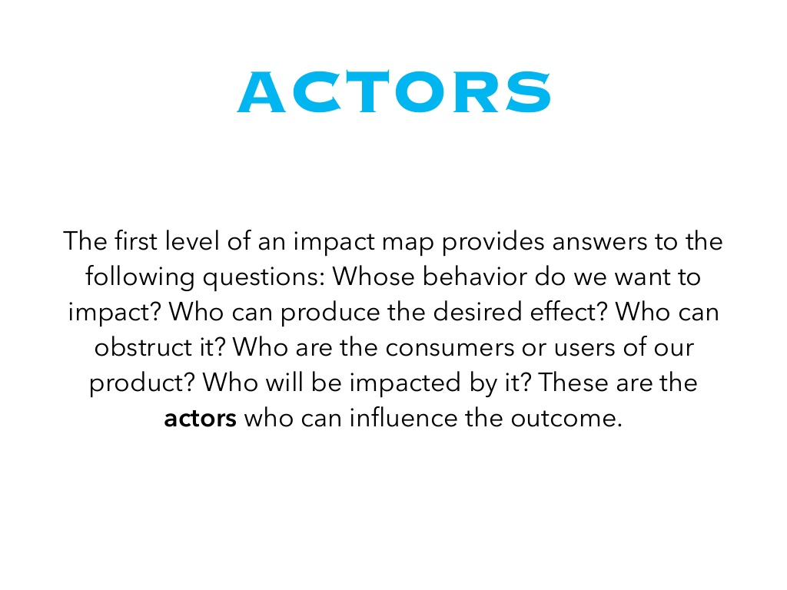
Who Aka Actors
Notes:
Discuss and try to answer next questions: WHO can produce the desired effect? WHO can obstruct it? WHO are the consumers or users of our product? WHO will be impacted by it? Here we think about real groups of people, not tech abstracts. Good examples: “Active Users”, “Our Marketing Guys”, “External Advertising Agency”.

Slide 23
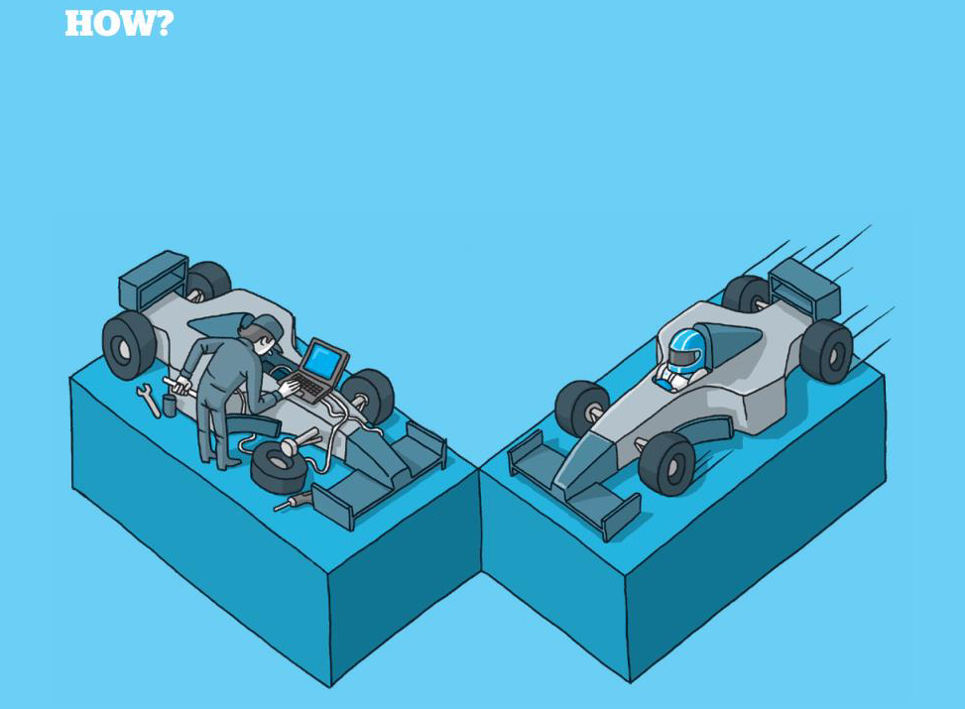
How Aka Impact
Notes:
Discuss and try to answer next questions: HOW should our actors’ behaviour change? HOW can they help us to achieve the goal? HOW can they obstruct or prevent us from succeeding? Good examples: “Recommending/posting (by Active Users)”, “Organise PR event (by Our Marketing Guys)”, “Publish our banners on big buildings in a city center (by External Advertising Agency)”. Notice that we still don’t talk about features. We talk about real people and their actions.

Slide 24
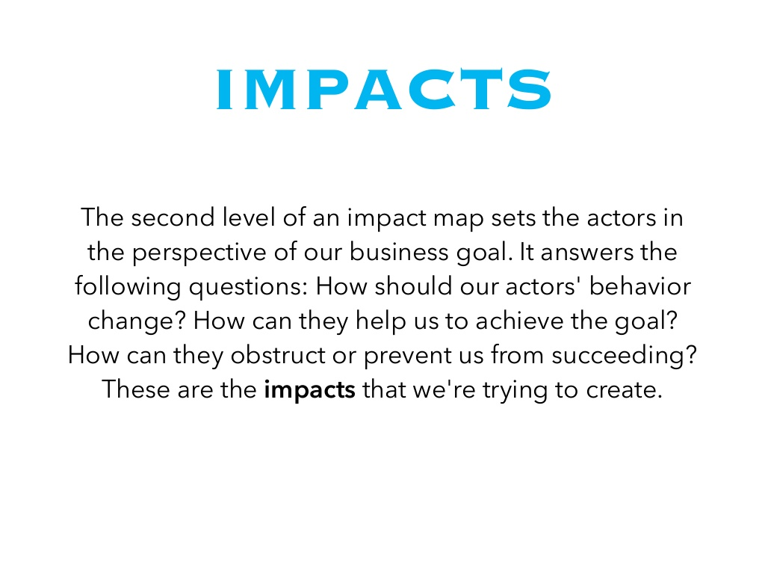
How Aka Impact
Notes:
Discuss and try to answer next questions: HOW should our actors’ behaviour change? HOW can they help us to achieve the goal? HOW can they obstruct or prevent us from succeeding? Good examples: “Recommending/posting (by Active Users)”, “Organise PR event (by Our Marketing Guys)”, “Publish our banners on big buildings in a city center (by External Advertising Agency)”. Notice that we still don’t talk about features. We talk about real people and their actions.

Slide 25
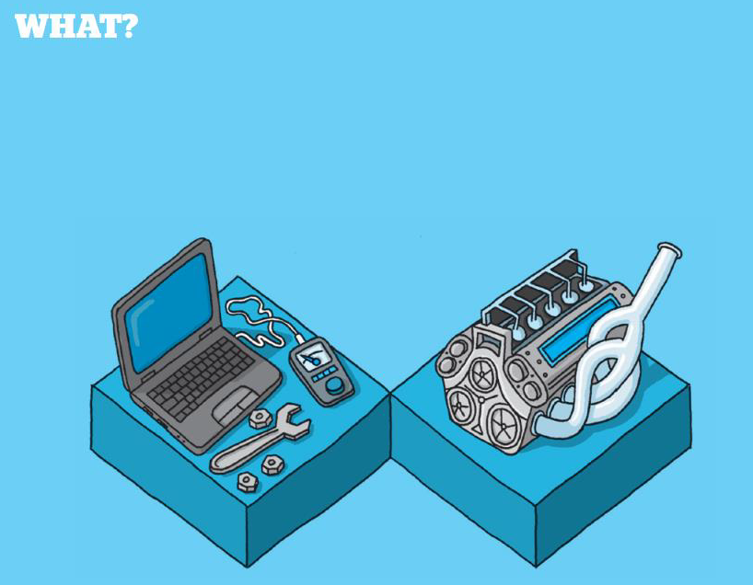
What Aka Deliverables
Notes:
Discuss and try to answer next question: WHAT can we do, as an organization or a delivery team, to support the required impacts? Notice that even here we talk not only about features but try to open all possible ideas (because very often it’s much cheaper to achieve something without even writing a single line of code). Good examples: “Content to share/post about (to support Posting)”, “Invites (to support PR event)”, “Banners design (to support banners on big buildings)”.
And a final secret ingredient. Remember that this technique shouldn’t be done by a lonely warrior (like Product Owner). That’s the way how to fail. This technique is a very powerful facilitation method that should be used for a rich group discussion (at least an overall product development team but ideally plus all more or less involved stakeholders)

Slide 26
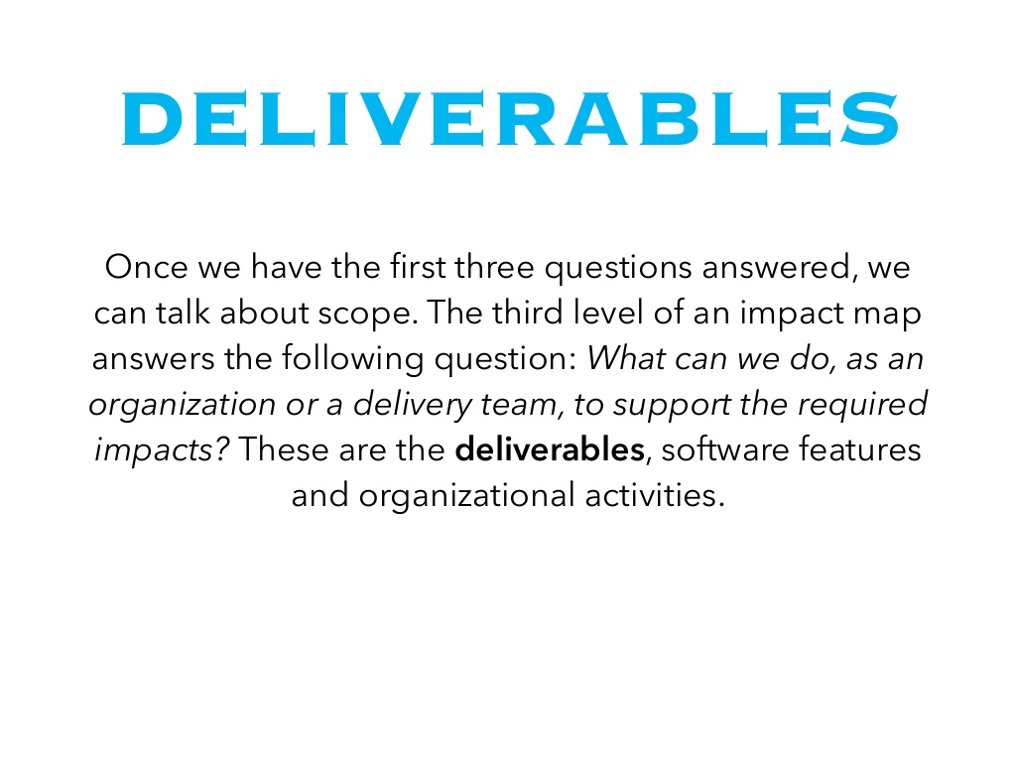
What Aka Deliverables
Notes:
Discuss and try to answer next question: WHAT can we do, as an organization or a delivery team, to support the required impacts? Notice that even here we talk not only about features but try to open all possible ideas (because very often it’s much cheaper to achieve something without even writing a single line of code). Good examples: “Content to share/post about (to support Posting)”, “Invites (to support PR event)”, “Banners design (to support banners on big buildings)”.
And a final secret ingredient. Remember that this technique shouldn’t be done by a lonely warrior (like Product Owner). That’s the way how to fail. This technique is a very powerful facilitation method that should be used for a rich group discussion (at least an overall product development team but ideally plus all more or less involved stakeholders)

Slide 27
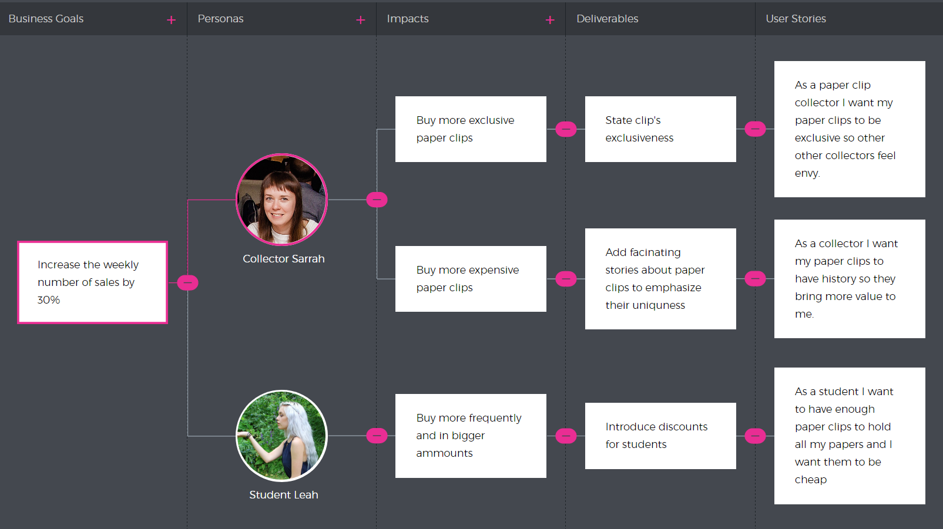
Impact Mapping + Stories
Notes:
At the end of each Impact Map branch, there’s a bunch of User Story that translates deliverables into specific features to be implemented. You’ll use them to calculate a business value, development efforts and set priorities accordingly
Impact mapping links your project to the real world and shows what impacts (if any) your deliverables will make. It brings more clarity to the team regarding goals and strategy.
Notice how we started with business goals and mapped our way straight to specific features that can be passed to the development team. And what’s really great – at this point, we can be sure that we’re implementing features that will certainly make an impact.
Done well, impact mapping leads to making better roadmap decisions, avoiding scope creep and over-engineered solutions – everything that makes projects lay an egg

Slide 28
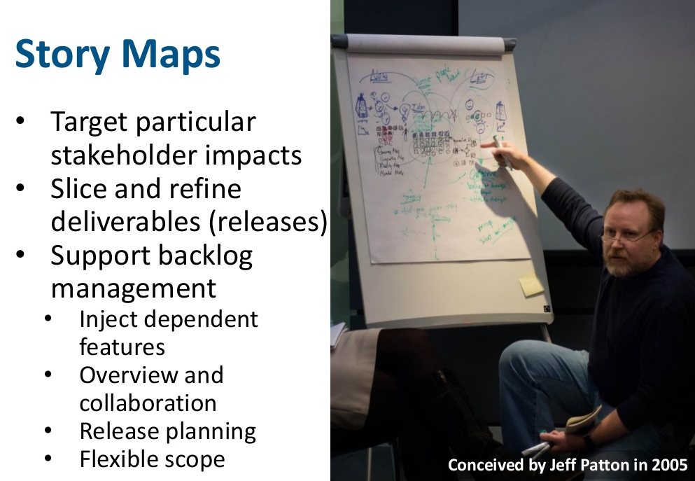
What is Story Mapping?
Notes:
Impact mapping is a strategic planning technique. It prevents organizations from getting lost while building products and delivering projects, by clearly communicating assumptions, helping teams align their activities with overall business objectives and make better roadmap decisions.

Slide 29
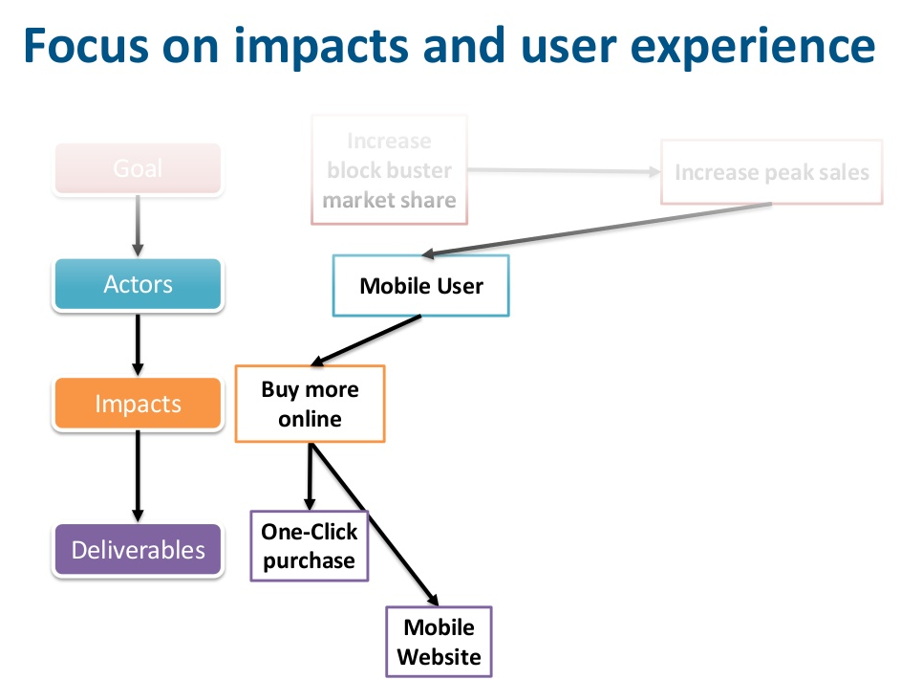
What is Impact Mapping?
Notes:
Impact mapping is a strategic planning technique. It prevents organizations from getting lost while building products and delivering projects, by clearly communicating assumptions, helping teams align their activities with overall business objectives and make better roadmap decisions.

Slide 30
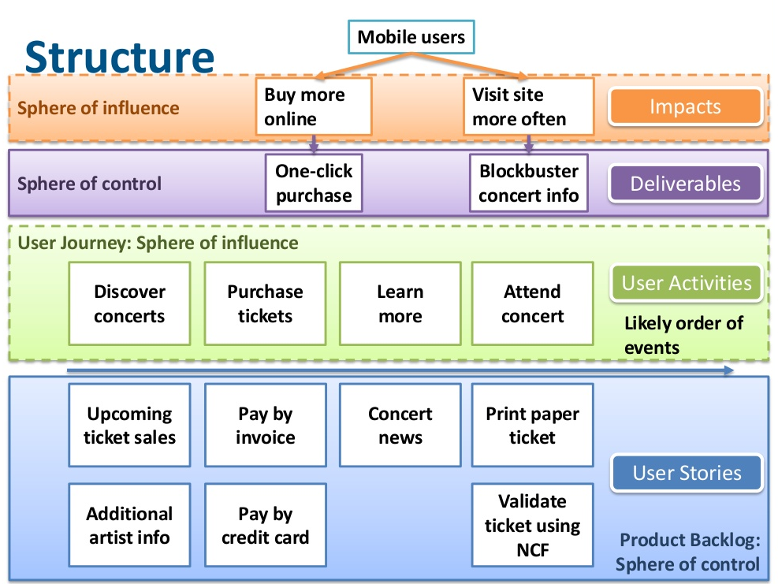
What is Impact Mapping?
Notes:
Impact mapping is a strategic planning technique. It prevents organizations from getting lost while building products and delivering projects, by clearly communicating assumptions, helping teams align their activities with overall business objectives and make better roadmap decisions.

Slide 31
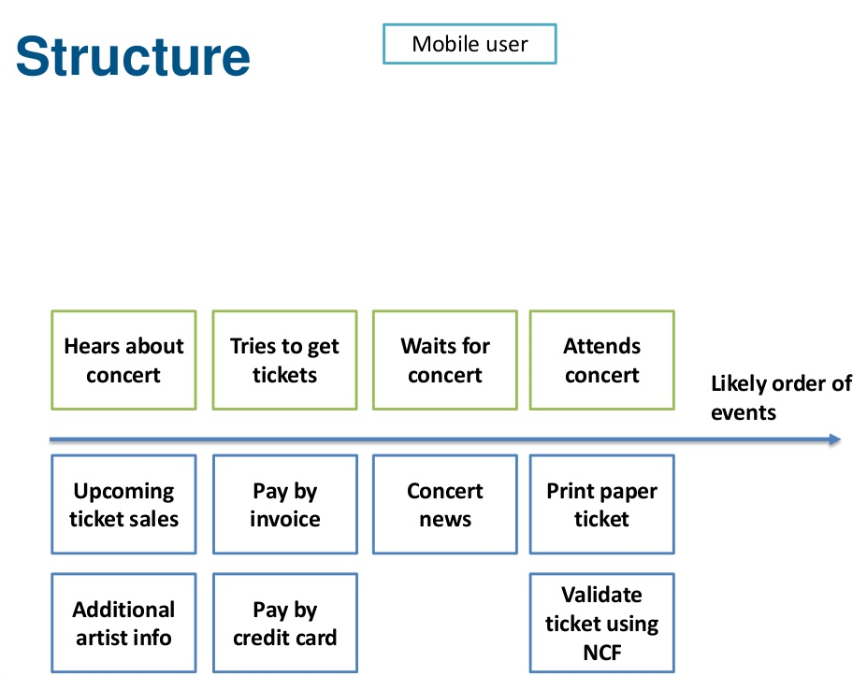
What is Impact Mapping?
Notes:
Impact mapping is a strategic planning technique. It prevents organizations from getting lost while building products and delivering projects, by clearly communicating assumptions, helping teams align their activities with overall business objectives and make better roadmap decisions.

Slide 32
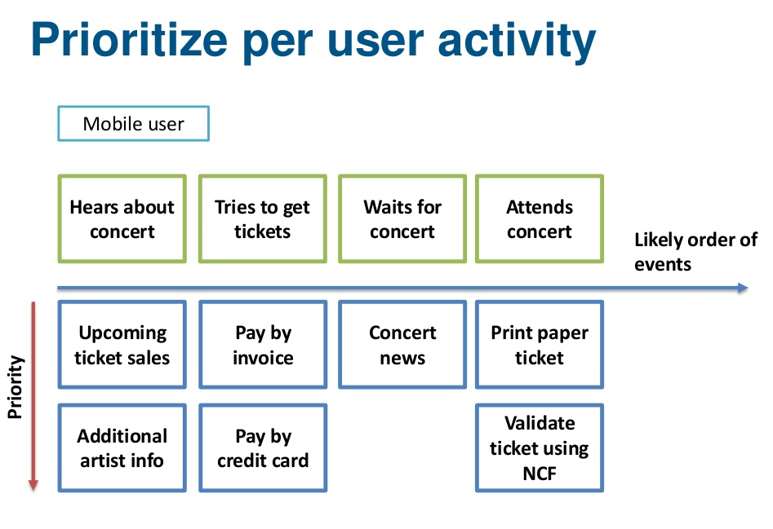
What is Impact Mapping?
Notes:
Impact mapping is a strategic planning technique. It prevents organizations from getting lost while building products and delivering projects, by clearly communicating assumptions, helping teams align their activities with overall business objectives and make better roadmap decisions.

Slide 33
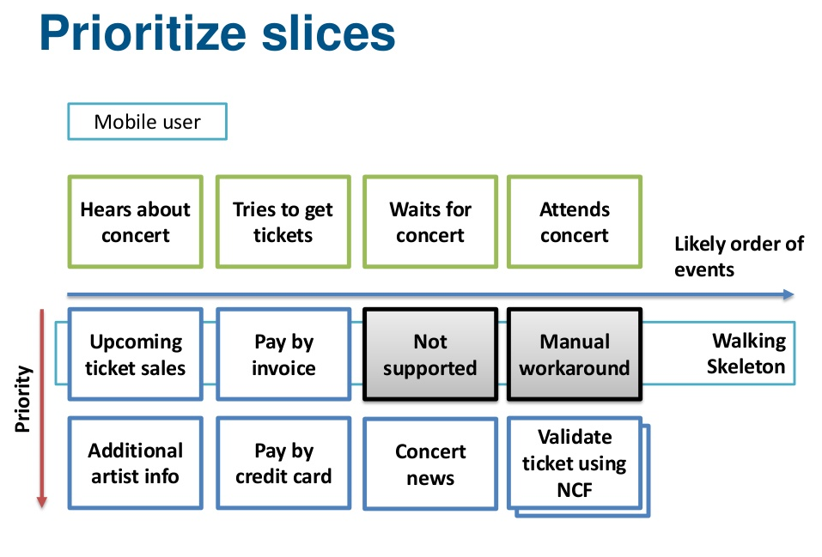
What is Impact Mapping?
Notes:
Impact mapping is a strategic planning technique. It prevents organizations from getting lost while building products and delivering projects, by clearly communicating assumptions, helping teams align their activities with overall business objectives and make better roadmap decisions.

Slide 34
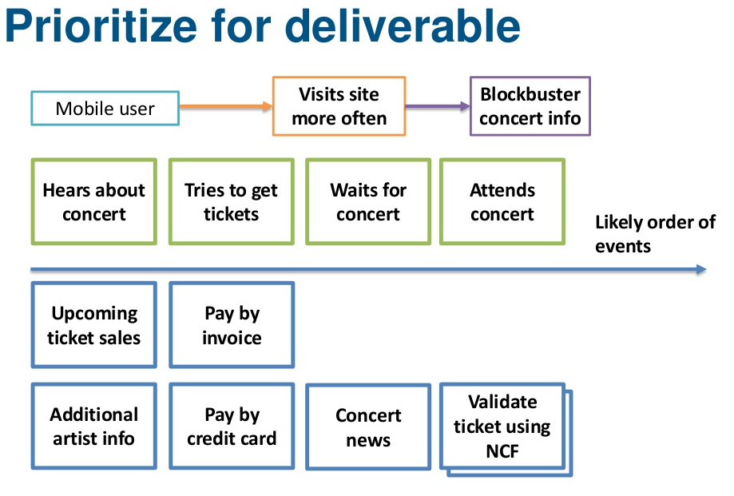
What is Impact Mapping?
Notes:
Impact mapping is a strategic planning technique. It prevents organizations from getting lost while building products and delivering projects, by clearly communicating assumptions, helping teams align their activities with overall business objectives and make better roadmap decisions.

Slide 35
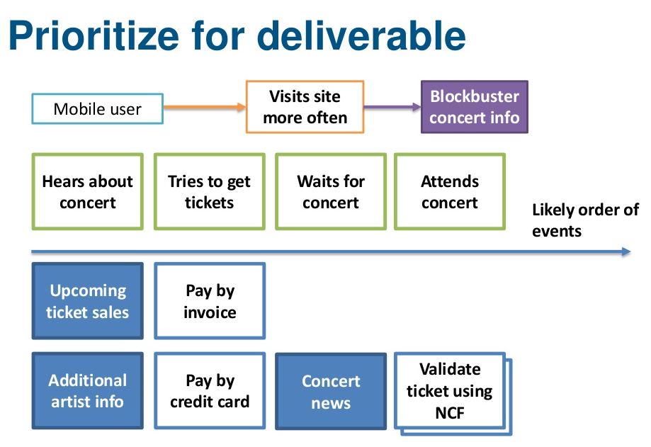
What is Impact Mapping?
Notes:
Impact mapping is a strategic planning technique. It prevents organizations from getting lost while building products and delivering projects, by clearly communicating assumptions, helping teams align their activities with overall business objectives and make better roadmap decisions.

Slide 36
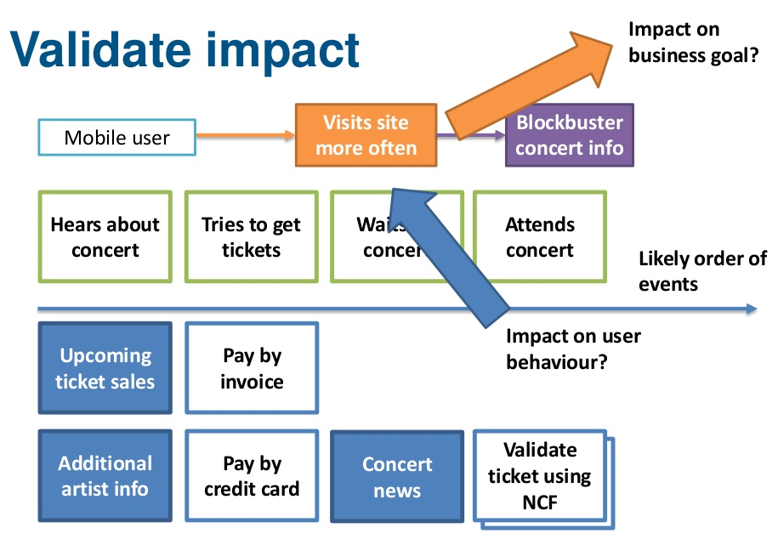
What is Impact Mapping?
Notes:
Impact mapping is a strategic planning technique. It prevents organizations from getting lost while building products and delivering projects, by clearly communicating assumptions, helping teams align their activities with overall business objectives and make better roadmap decisions.

Slide 37
Exercise
Notes:
At the end of each Impact Map branch, there’s a bunch of User Story that translates deliverables into specific features to be implemented. You’ll use them to calculate a business value, development efforts and set priorities accordingly
Impact mapping links your project to the real world and shows what impacts (if any) your deliverables will make. It brings more clarity to the team regarding goals and strategy.
Notice how we started with business goals and mapped our way straight to specific features that can be passed to the development team. And what’s really great – at this point, we can be sure that we’re implementing features that will certainly make an impact.
Done well, impact mapping leads to making better roadmap decisions, avoiding scope creep and over-engineered solutions – everything that makes projects lay an egg

Slide 38
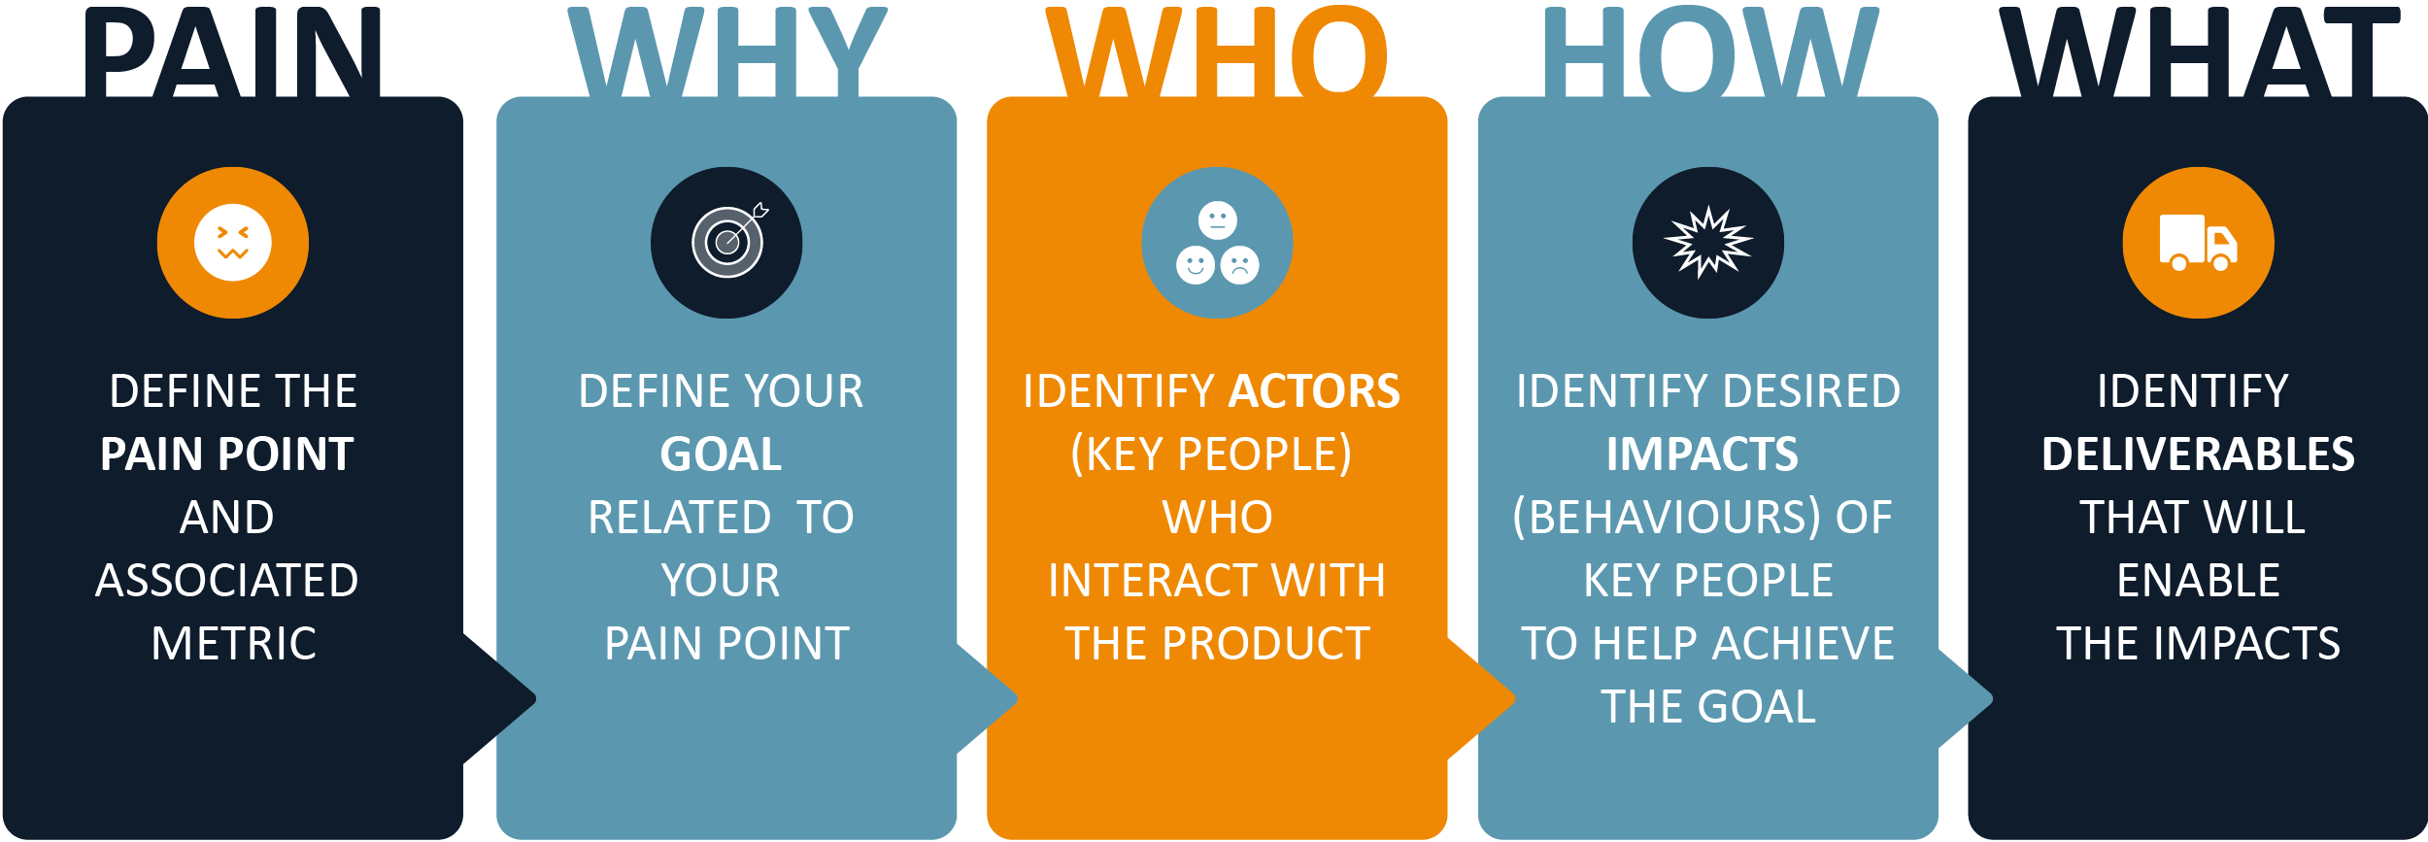
Exercise
Notes:
At the end of each Impact Map branch, there’s a bunch of User Story that translates deliverables into specific features to be implemented. You’ll use them to calculate a business value, development efforts and set priorities accordingly
Impact mapping links your project to the real world and shows what impacts (if any) your deliverables will make. It brings more clarity to the team regarding goals and strategy.
Notice how we started with business goals and mapped our way straight to specific features that can be passed to the development team. And what’s really great – at this point, we can be sure that we’re implementing features that will certainly make an impact.
Done well, impact mapping leads to making better roadmap decisions, avoiding scope creep and over-engineered solutions – everything that makes projects lay an egg

Slide 39
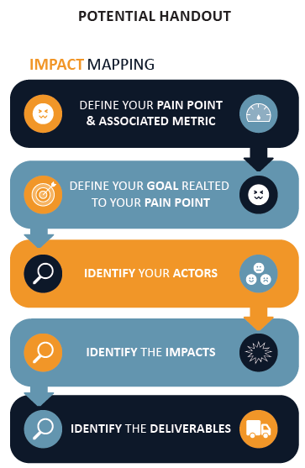
Exercise
Notes:
At the end of each Impact Map branch, there’s a bunch of User Story that translates deliverables into specific features to be implemented. You’ll use them to calculate a business value, development efforts and set priorities accordingly
Impact mapping links your project to the real world and shows what impacts (if any) your deliverables will make. It brings more clarity to the team regarding goals and strategy.
Notice how we started with business goals and mapped our way straight to specific features that can be passed to the development team. And what’s really great – at this point, we can be sure that we’re implementing features that will certainly make an impact.
Done well, impact mapping leads to making better roadmap decisions, avoiding scope creep and over-engineered solutions – everything that makes projects lay an egg

Slide 40
Exercise
1. Define the Pain Point
A pain point can be identified using customer feedback (e.g. NPS), customer / market research or business analytics.
The pain point may be that our churn rate for a software product is 20% for subscription customers. We want to reduce this percentage to improve revenue.
Notes:
At the end of each Impact Map branch, there’s a bunch of User Story that translates deliverables into specific features to be implemented. You’ll use them to calculate a business value, development efforts and set priorities accordingly
Impact mapping links your project to the real world and shows what impacts (if any) your deliverables will make. It brings more clarity to the team regarding goals and strategy.
Notice how we started with business goals and mapped our way straight to specific features that can be passed to the development team. And what’s really great – at this point, we can be sure that we’re implementing features that will certainly make an impact.
Done well, impact mapping leads to making better roadmap decisions, avoiding scope creep and over-engineered solutions – everything that makes projects lay an egg

Slide 41
Exercise
2. Define the Goal
The goal should relate to the pain point’s metric so that we can track the effectiveness of our actions – e.g. we will reduce churn to 5%.
Goal: Customer churn rate of 5%.
Notes:
At the end of each Impact Map branch, there’s a bunch of User Story that translates deliverables into specific features to be implemented. You’ll use them to calculate a business value, development efforts and set priorities accordingly
Impact mapping links your project to the real world and shows what impacts (if any) your deliverables will make. It brings more clarity to the team regarding goals and strategy.
Notice how we started with business goals and mapped our way straight to specific features that can be passed to the development team. And what’s really great – at this point, we can be sure that we’re implementing features that will certainly make an impact.
Done well, impact mapping leads to making better roadmap decisions, avoiding scope creep and over-engineered solutions – everything that makes projects lay an egg

Slide 42
Exercise
3. Identify the actors
An actor is any person or group that interacts with the product. Actors may be blockers who seek to stop us from reaching our goal, or individuals whose behaviour has a positive impact.
We can influence our actors’ behaviour to help us to reach our goal. To maximise effectiveness, we’ll focus on the actors who have the most influence (key actors).
In the churn example above, key actors would include the customer service team and the customer. The customer interacts with the customer service team when they’re experiencing product or service difficulties or seeking to end their subscription – so we can use this interaction as an opportunity to improve our customer experience and ensure customers stay subscribed.
Actors: Customer service team, customers.
Notes:
At the end of each Impact Map branch, there’s a bunch of User Story that translates deliverables into specific features to be implemented. You’ll use them to calculate a business value, development efforts and set priorities accordingly
Impact mapping links your project to the real world and shows what impacts (if any) your deliverables will make. It brings more clarity to the team regarding goals and strategy.
Notice how we started with business goals and mapped our way straight to specific features that can be passed to the development team. And what’s really great – at this point, we can be sure that we’re implementing features that will certainly make an impact.
Done well, impact mapping leads to making better roadmap decisions, avoiding scope creep and over-engineered solutions – everything that makes projects lay an egg

Slide 43
Exercise
4. Identify the impacts
Now that we’ve identified key actors we can explore impacts (actor behaviours) that will help us to achieve our goal. (If a person’s behaviour is a risk to achieving our goal, we can list minimising the effects of this negative behaviour as a desired impact.)
Notes:
At the end of each Impact Map branch, there’s a bunch of User Story that translates deliverables into specific features to be implemented. You’ll use them to calculate a business value, development efforts and set priorities accordingly
Impact mapping links your project to the real world and shows what impacts (if any) your deliverables will make. It brings more clarity to the team regarding goals and strategy.
Notice how we started with business goals and mapped our way straight to specific features that can be passed to the development team. And what’s really great – at this point, we can be sure that we’re implementing features that will certainly make an impact.
Done well, impact mapping leads to making better roadmap decisions, avoiding scope creep and over-engineered solutions – everything that makes projects lay an egg

Slide 44
Exercise
Customer service team impacts
Let’s assume that a customer is more likely to stay subscribed if the customer service team goes the extra mile to fix their problem when they are unhappy. We’ll define “going the extra mile” as contacting the customer directly and helping them achieve what they need to with the product. Similarly, the speed at which problems are resolved could influence subscription – i.e. customers are more likely to stay subscribed if the customer service team is responsive.
Notes:
At the end of each Impact Map branch, there’s a bunch of User Story that translates deliverables into specific features to be implemented. You’ll use them to calculate a business value, development efforts and set priorities accordingly
Impact mapping links your project to the real world and shows what impacts (if any) your deliverables will make. It brings more clarity to the team regarding goals and strategy.
Notice how we started with business goals and mapped our way straight to specific features that can be passed to the development team. And what’s really great – at this point, we can be sure that we’re implementing features that will certainly make an impact.
Done well, impact mapping leads to making better roadmap decisions, avoiding scope creep and over-engineered solutions – everything that makes projects lay an egg

Slide 45
Exercise
Customer impacts
For the customer, let’s hypothesise that if they feel a sense of community while using the product and are genuinely engaged, they are more likely to stay subscribed.
Customer service team impacts:
Go the extra mile to fix the problem if customer is unhappy
Resolve customer problems faster
Customer impacts:
Is engaged with the product (uses it at least once a day)
Interacts with a community while using the product
Notes:
At the end of each Impact Map branch, there’s a bunch of User Story that translates deliverables into specific features to be implemented. You’ll use them to calculate a business value, development efforts and set priorities accordingly
Impact mapping links your project to the real world and shows what impacts (if any) your deliverables will make. It brings more clarity to the team regarding goals and strategy.
Notice how we started with business goals and mapped our way straight to specific features that can be passed to the development team. And what’s really great – at this point, we can be sure that we’re implementing features that will certainly make an impact.
Done well, impact mapping leads to making better roadmap decisions, avoiding scope creep and over-engineered solutions – everything that makes projects lay an egg

Slide 46
Exercise
5. Identify the deliverables
Now we must identify and design features to enable the impacts to achieve our goal. By identifying at least one deliverable per impact, we will have a list of tasks we can begin to action.
Customer service team deliverables
Live online chat will help the customer service team to resolve product-related problems faster, thereby enabling this impact. Similarly, a feedback form can capture customer feedback, helping the team to understand if the customer is unhappy with the product and allowing them to proactively contact them.
Customer deliverables
We might send emails with product tips and monitor email open rates as a starting point to improve customer engagement. We could also provide a function that allows customers to share content with other users, as a way to encourage them to use the product with a wider community.
Notes:
At the end of each Impact Map branch, there’s a bunch of User Story that translates deliverables into specific features to be implemented. You’ll use them to calculate a business value, development efforts and set priorities accordingly
Impact mapping links your project to the real world and shows what impacts (if any) your deliverables will make. It brings more clarity to the team regarding goals and strategy.
Notice how we started with business goals and mapped our way straight to specific features that can be passed to the development team. And what’s really great – at this point, we can be sure that we’re implementing features that will certainly make an impact.
Done well, impact mapping leads to making better roadmap decisions, avoiding scope creep and over-engineered solutions – everything that makes projects lay an egg

Slide 47
Exercise
Customer service team deliverables:
Go the extra mile to fix the problem if customer is unhappy
Introduce form to allow customers to send product feedback
Resolve customer problems faster
Live chat to allow instant communication
Customer deliverables:
Is engaged with the product
Send customer usage tips and questions about product experience
Interacts with a community while using the product
Function for people to share their content
Notes:
At the end of each Impact Map branch, there’s a bunch of User Story that translates deliverables into specific features to be implemented. You’ll use them to calculate a business value, development efforts and set priorities accordingly
Impact mapping links your project to the real world and shows what impacts (if any) your deliverables will make. It brings more clarity to the team regarding goals and strategy.
Notice how we started with business goals and mapped our way straight to specific features that can be passed to the development team. And what’s really great – at this point, we can be sure that we’re implementing features that will certainly make an impact.
Done well, impact mapping leads to making better roadmap decisions, avoiding scope creep and over-engineered solutions – everything that makes projects lay an egg

Slide 48
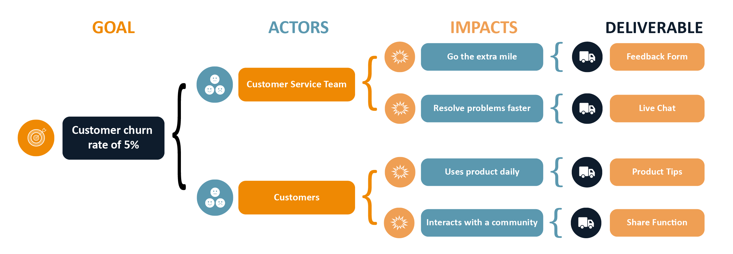
Exercise
6. Creating your impact map
Deliverables are now clearly outlined and can be mapped.
You can use impact mapping to develop user stories or epics for delivery:
As an [Actor], I want [Deliverable], so I can [Make Impact]
For example:
As a customer service representative, I want live online chat, so I can resolve customer problems faster
Notes:
At the end of each Impact Map branch, there’s a bunch of User Story that translates deliverables into specific features to be implemented. You’ll use them to calculate a business value, development efforts and set priorities accordingly
Impact mapping links your project to the real world and shows what impacts (if any) your deliverables will make. It brings more clarity to the team regarding goals and strategy.
Notice how we started with business goals and mapped our way straight to specific features that can be passed to the development team. And what’s really great – at this point, we can be sure that we’re implementing features that will certainly make an impact.
Done well, impact mapping leads to making better roadmap decisions, avoiding scope creep and over-engineered solutions – everything that makes projects lay an egg

Slide 49
Backup Slides
Notes:
At the end of each Impact Map branch, there’s a bunch of User Story that translates deliverables into specific features to be implemented. You’ll use them to calculate a business value, development efforts and set priorities accordingly
Impact mapping links your project to the real world and shows what impacts (if any) your deliverables will make. It brings more clarity to the team regarding goals and strategy.
Notice how we started with business goals and mapped our way straight to specific features that can be passed to the development team. And what’s really great – at this point, we can be sure that we’re implementing features that will certainly make an impact.
Done well, impact mapping leads to making better roadmap decisions, avoiding scope creep and over-engineered solutions – everything that makes projects lay an egg

Slide 50
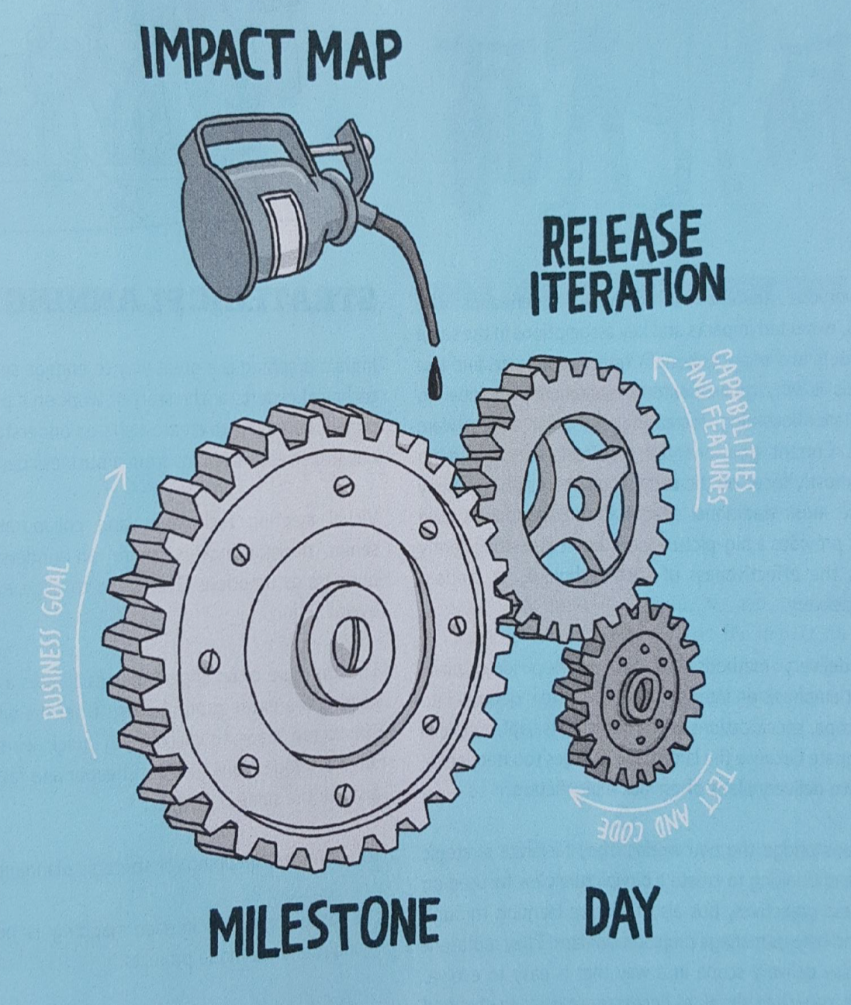
What is Impact Mapping?
Notes:
Impact mapping is a strategic planning technique. It prevents organizations from getting lost while building products and delivering projects, by clearly communicating assumptions, helping teams align their activities with overall business objectives and make better roadmap decisions.

Slide 51
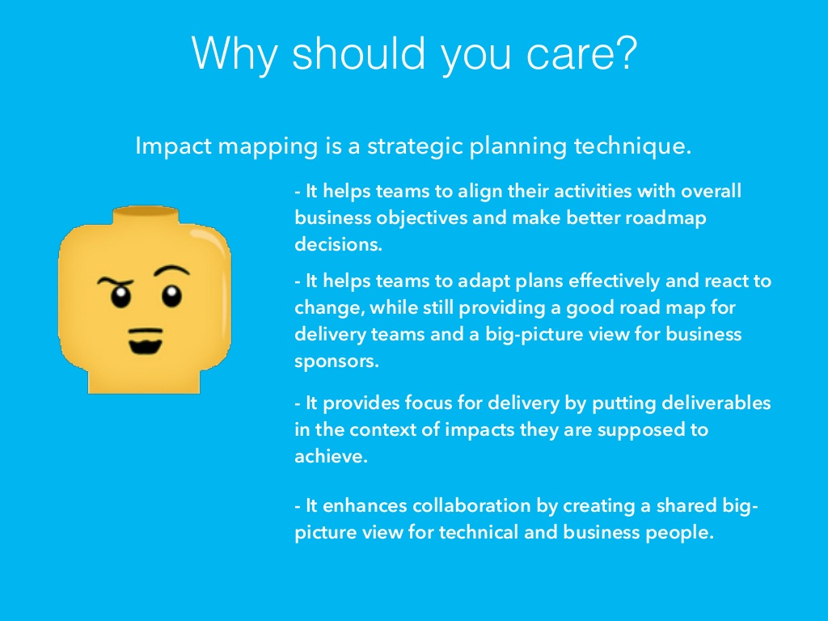
What is Impact Mapping?
Notes:
Impact mapping is a strategic planning technique. It prevents organizations from getting lost while building products and delivering projects, by clearly communicating assumptions, helping teams align their activities with overall business objectives and make better roadmap decisions.

Slide 52
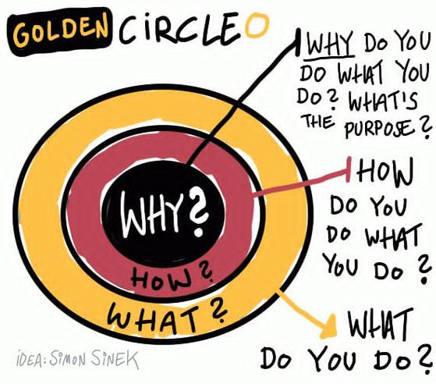
Why Aka Goal
The "Why" of impact mapping is strongly related to Simon Sinek’s Golden Circle which he describes in his book "Start with a Why" or his TED talk.
According to Sinek consists the Golden Circle of three layers:
Why - This is the core belief of the business. It's why the business exists.
How - This is how the business fulfills that core belief.
What - This is what the company does to fulfill that core belief.
Notes:
Ingrid Domingues explains the similarities between image maps and Simon Sinek’s Golden Circle straight forward:
"the impact map describes the business and user values that a new product or service is expected to generate.
why this solution is a good investment for the business
how people are going to gain from it
what the solution should encompass in order to promote user satisfaction and business prosperity."
Thus, the "Why"-question leads us to the following two questions:
Do you solve the right problem? and How do you know?
How do you measure the success of your product/service?
To answer the "Why" question, Gojko suggests to use the acronym “SMART”: “Specific, Measurable, Action-oriented, Realistic, and Timely” — according to Wikipedia there are multiple variants to interpret SMART.
For multiple goals use the well-known MoSCoW prioritisation method:
"Must have, Should have, Could have, Won't have".
Through the exercise, recursively check the goal back to the basic premise. What we believe will help us accomplish our business need (e.g. increased revenue, reduction in cost, etc.).

